Slide 1
BRAND PERSONALITY PRESENTATION: COCA COLA
BY (Insert your name here)

Slide 2
Introduction
Just like humans, brands have personalities which enables them to connect with their customers.
They can be traits which are humanistic in nature
Brand personalities are a result of the marketing mix, packaging and the perception of the customers towards the brand.
Brand personalities also emanate from the benefits the customers attach to the brands.
Notes:
Brand personality simply refers to the personification of a brand (Pahwa, 2018). A brand personality can be described as a set of humanistic features ascribed or assigned to a brand. Such traits and characteristic can include caring, honest, unique among others (Pahwa, 2018). These humanistic traits emanate from the way the brand is marketed. They can also emanate from the packaging of the brand products and the presentation of the brand to the market. Some define brand personality as the consumer’s perception towards the brand beyond the benefits of the brand to the customer (Gandhi, 2014).

Slide 3
How Coca cola develops its brand personality
Coca-Coca develops its brand personality through its products.
It also develops its brand personality through the marketing strategies.
Incorporation of customer wants and ideas in the production of brand products.
Ensuring consistency and keeping to the line of production
Notes:
Developing a brand personality is one of the hardest things that organizations face and Coca-Cola is no exception. After developing a brand personality, it is even more difficult to maintain it because of the changing consumer perceptions towards the brand (Gandhi, 2014). Coca Cola uses its product to develop and maintain its brand personality. Through the consistent production of non-alcoholic drinks and engaging in production of pure and enhanced mineral water, the consumer perception toward the brand has continued to be positive. Another strategy used to develop and maintain brand personality by Coca Cola is conducting research and incorporating the needs of the customers in the production. This bundled with consistency ensured a firm brand personality of Coca Cola.

Slide 4
Coca cola ad
Taste the feeling is one of the Coca Cola ads with strong brand personality
The add was used to market the coke product of coca cola across the world.
With this ad depicts strong brand personalities such as honest, cheerful, reliable, honest successful, charming and spirited.
This is an add that expresses the feeling of people as they drink a Coca Cola product and how the product is experienced by diverse people across the world.
The link to the ad is https://www.youtube.com/watch?v=tqXKjbtCtxg
Notes:
Taste the feeling is one of the epic advertisements that have thrilled people all over the world (Coca Cola, 2016). It communicates a brand personality of excitement and cheerful.
The advert was used across the world to market and promote the coca cola product, specifically the Coca Cola soda also known as coke. In the add, different people are depicted enjoying the feeling by drinking the coca cola soda. The ad shows how people are having fun and excitement and how the soda strengthens love between people and how it brings happiness.

Slide 5
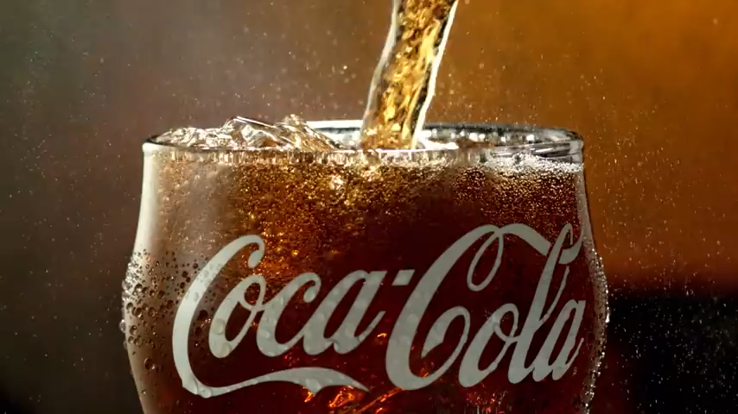
The ‘taste the feeling’ advert
Notes:
This is the video advert that can be found on YouTube by following the URL link in the previous slide. It encourages you to taste the feeling.
This campaign was rolled out in 2016 under the tagline “Open Happiness” which was used to advertise the product across various continents of the world.

Slide 6
Brand Personality in the ad
The brand personalities communicated by the advert include the following:
  Honest
  Cheerful
  Reliable
  Successful, and
  Charming
Notes:
The “Taste the Feeling” ad communicates a number of brand personalities. First, the advert depicts the brand as hones in the sense that it truly gives its consumers the happiness they are looking for in a soft drink. Since the brand is honest, it creates cheerful moments in the lives of the consumers. Therefore, the brand is reliable because people can rely on it to bring happiness in their lives and strengthen the love between them. The ad also depicts the coca cola brand as charming and successfully that everybody that tastes it opens a world of happiness in his or her life.

Slide 7
Brand Personality in terms of the dimensions
In terms of the dimensions used to measure brand personality, the Coca Cola Brand Personalities in the previous slide achieve the following:
  Sincerity
  Excitement
  Competence, and
  Sophistication.
Notes:
Under Sincerity dimension-the product personalities communicated include honest and cheerful (Gandhi, 2014).
Under Excitement dimension-the brand personality depicted are spirited and imaginative (Gandhi, 2014).
Under Competence dimension-the brand personality depicted in the ad are reliable and successful (Gandhi, 2014).
Under Sophistication dimension-the brand personality depicted include charming (Gandhi, 2014).

Slide 8
Techniques used in the ad
The ad utilizes various techniques of marketing.
One of the techniques is user imagery
The other one is celebrity endorser.
Executional factors as a strategy is also used in the ad.
Notes:
User imagery is the main technique used in the “Taste the Feeling” advert of Coca Cola. The users are depicted having fun, enjoying and opening a world of happiness by drinking the coca cola soda. Various celebrities such as musicians are also used to endorse the brand (there is a section in add showing a music drumist having fun with funs as he drums the beats after drinking a coca cola). The techniques link to the brand personalities of charming and carful and reliable as well as successful among other personalities.

Slide 9
Personalities to have in a brand and how the Brand personality impact competitive positioning
The best brand personality should vary depending on the nature of the business the brand engages in.
Nevertheless, the best brand personalities to have in brand are those that ensure perfect connection between the brand and its customers.
The brand personalities falling under sincerity dimension, sophistication dimension and excitement dimensions are the best for brands such as coca cola.
The brand personality of coca cola impacts competitive positioning by ensuring that the brand has a close connection with its consumers and therefore winning loyalty among customers and making it difficult for them to shift to other brands.
Notes:
he brand personality of Coca Cola impacts competitive positioning by ensuring that the brand has a close connection with its consumers and therefore winning loyalty among customers and making it difficult for them to shift to other brands such as Pepsi. This way, Coca Cola fights of competition from other brands in the market and establishes itself as a strong global brand that in not bowing to competition pressure any time soon. The connection with customers ensures the brand is competitive and consistent.

Slide 10
How the ad impacts believe and motivation to purchase the product
This advert definitely arouses interests in me to purchase a coca cola soda and taste the feeling. This is because I want to open a world of happiness lie those in the ad.
The ad also strengthens my believe in the brand as a reliable producer of soft drinks that will surely not disappoint.
Through the ad “Taste the Feeling” I have developed a strong believe in the capability of Coca Cola products t bring a strong love bond among people and between me and my loved ones.

Slide 11
References
Gandhi, K. (2014). A Study on Brand Personality of Coca-Cola and Pepsi. Nternational Journal of Conceptions on Management and Social Sciences, 2, 10-13.
Coca Cola (2016). Coca-Cola: Taste the Feeling. Retrieved from YouTube on 28th February 2019 at https://www.youtube.com/watch?v=tqXKjbtCtxg
Pahwa, A. (2018). What is Brand Personality? Definition & Examples. Accessed on 28th February 2019 from https://www.feedough.com/brand-personality-definition-examples/

